Slide 1
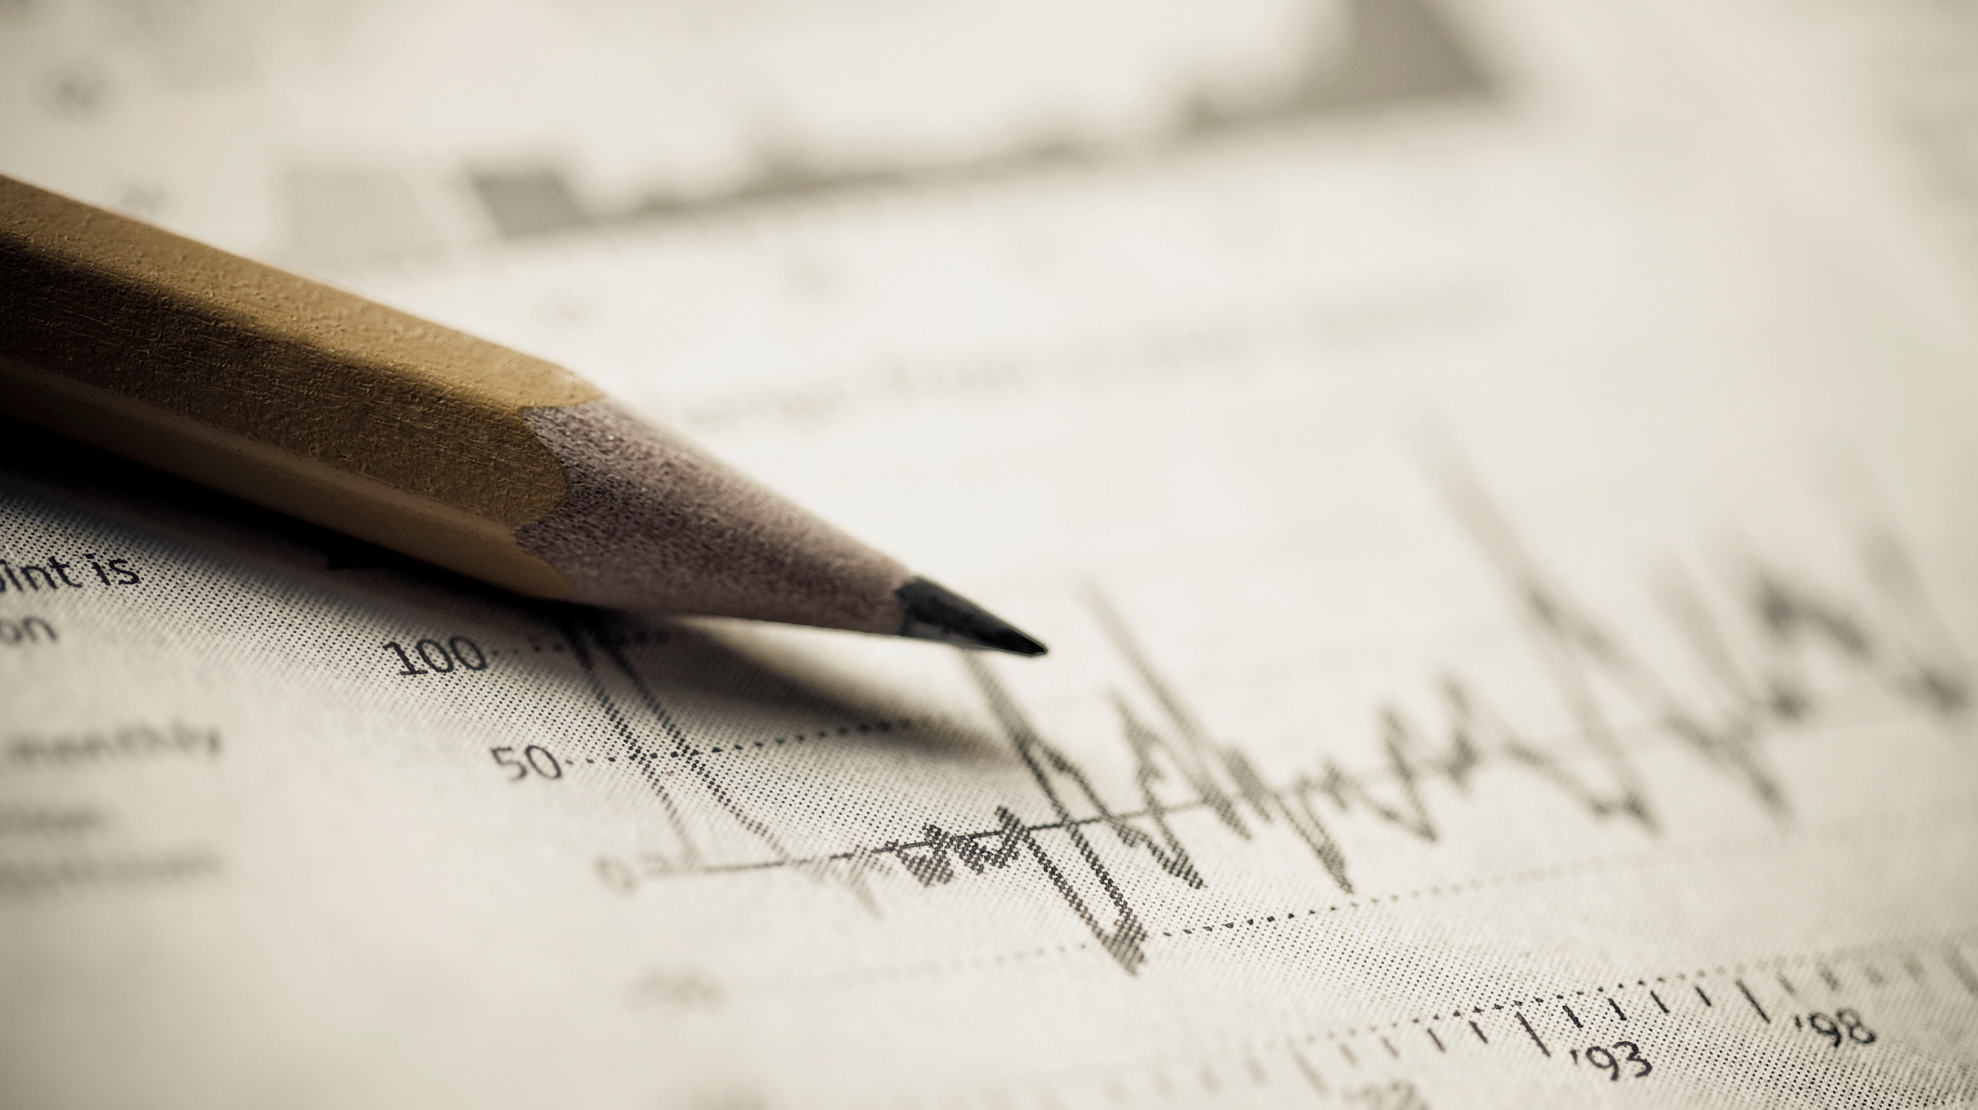
Presidential Speeches and Job Performance: Don’t be Neutral
John Kellogg

Slide 2
Overview and Purpose
The words of the United States President often shape or demonstrate the path of the office holder.
Can we determine if the words of the president effect the people of the nation?
If we can detect the effect of the words, can we track any useable trends for future presidents, speechwriters or researchers?
A word on President Donald Trump:
We felt it would be difficult to keep the biasness out of the project both in ourselves and the data.
Gallup Inc.’s attempts to keep their studies unbiased
The last president included in this study is President Barack Obama.
Notes:
If someone can track the reception of a speech, the future speeches can be geared to fill in any gap. The language of the next speeches can be altered to effectively drive the US citizenry toward acceptance and approval of the officeholder.
Some advisors questioned weather the poll questionees already had responses on the President before the poll was started and any question asked.

Slide 3
Model and Process
Multiple international studies put international presidential speeches through SA
Miranda and Bringula - State of Nation Address (SONA) of the past 13 Philippine presidents.
VADER, TextBlob and Twitter
Data:
Gallup Inc. – Job Approval Numbers
Clearly defined published polling process
Created Rolling average to track change in approval numbers
Miller Center at the University of Virginia
Repository of Speeches
Roadblocks
Earlier Gallup Polls
Matching Process
5 key values per text set: Positive, Negative, Neutral, Polarity, and Subjectivity.
Positive, Neutral and Negative scores percentage ratio of words
Polarity is a single value score which lies between [-1,1]
-1 indicates a highly negative sentiment
1 indicates a highly positive sentiment
Subjectivity is a single value score which lies between [0,1]
The closer to zero the more subjective
The closer to 1 the more objective
Notes:
Have others done it before me?
John Paul Miranda and Rex Bringula in 2020 (Miranda & Bringula, 2021) used the State of Nation Address (SONA) of the past 13 Philippine presidents to get the general sentiment of the addresses during specific periods of Philippine governments.
Their findings showed the positive and negative sentiments followed the general state of the period.
For instance, the speeches with the lowest sentiment scores were during the martial law periods around 1974.
Valence Aware Dictionary for Sentiment Reasoning
Text can have 20% Positive, 77% Neutral, and 3% Negative words leading us to summarize the text as more positive than negative.
Always have a neutral value as it would be very difficult to effectively communicate while only using positive and negative words

Slide 4
Analysis
General Speech Numbers
12 Presidents
Median 22 speeches per Term
Note:
Carter Negative/Neutral/Positive
Obama Negative/Neutral/Positive

Slide 5
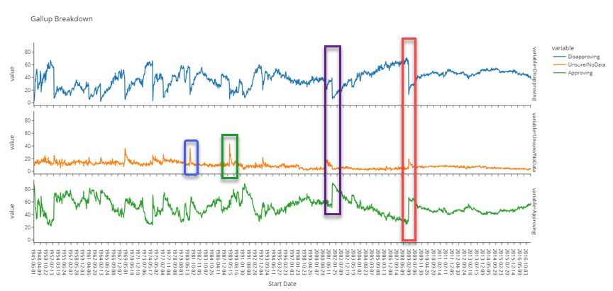
Analysis
Key Events Theory
Major Event Theory (Schubert, Stewart, and Curran)
Blue Box: Reagan’s First Press Conference
Green Box: H.W Bush Inaugural Address
Purple Box: W. Bush on 9/11
Red Box: Obama Inaugural
Carter deemed the Median President
Notes:
Schubert, Stewart, and Curran (Schubert, Stewart, & Curran, 2002) studied the dramatic jump in approval after W’s speech to congress the day of the attack. The effect does not last long.
Start the Carter speech patterns

Slide 6
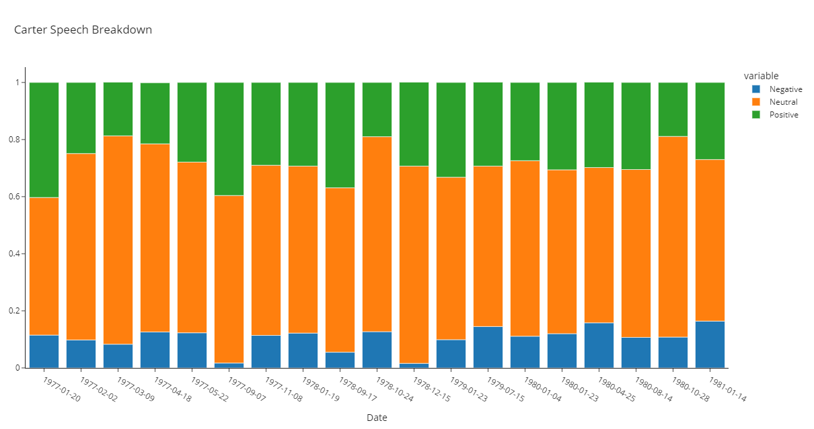
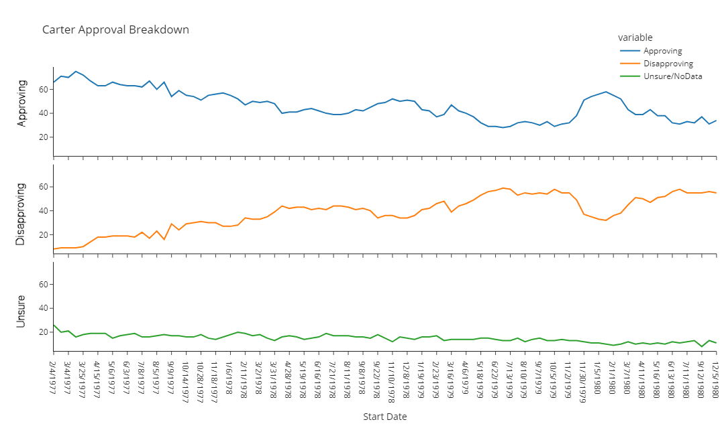
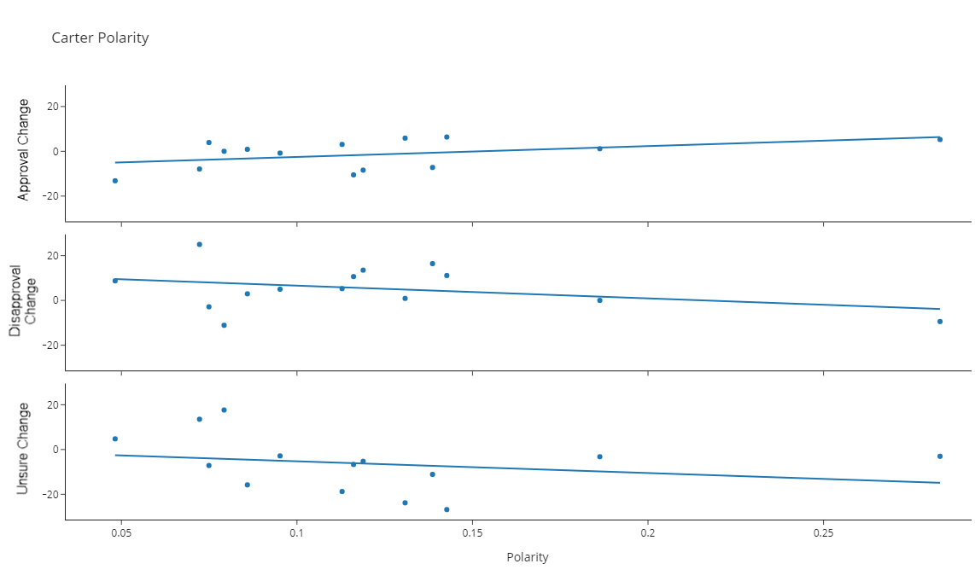
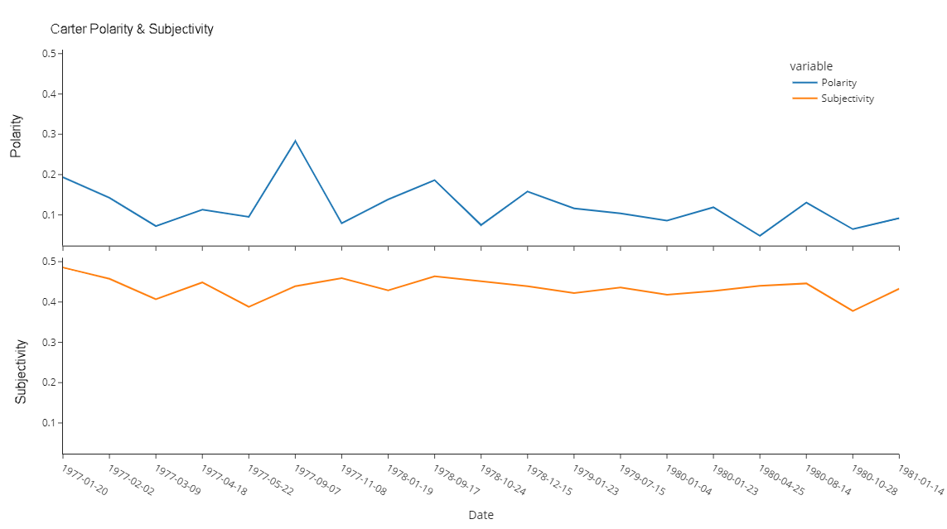
Jimmy Carter
Mirror Effect
Sept 7, 1977
Panama Canal Speech
Heavy outliers in all 5 indicators
Unsure goes up - Polarity and Subjectivity drop
Not enough Correlation with Positive, Neutral, and Negative
Notes:
1977/09/07 – Panama Canal Speech
1979/07/15 – Malaise Speech “ Crisis of Confidence” Speech

Slide 7
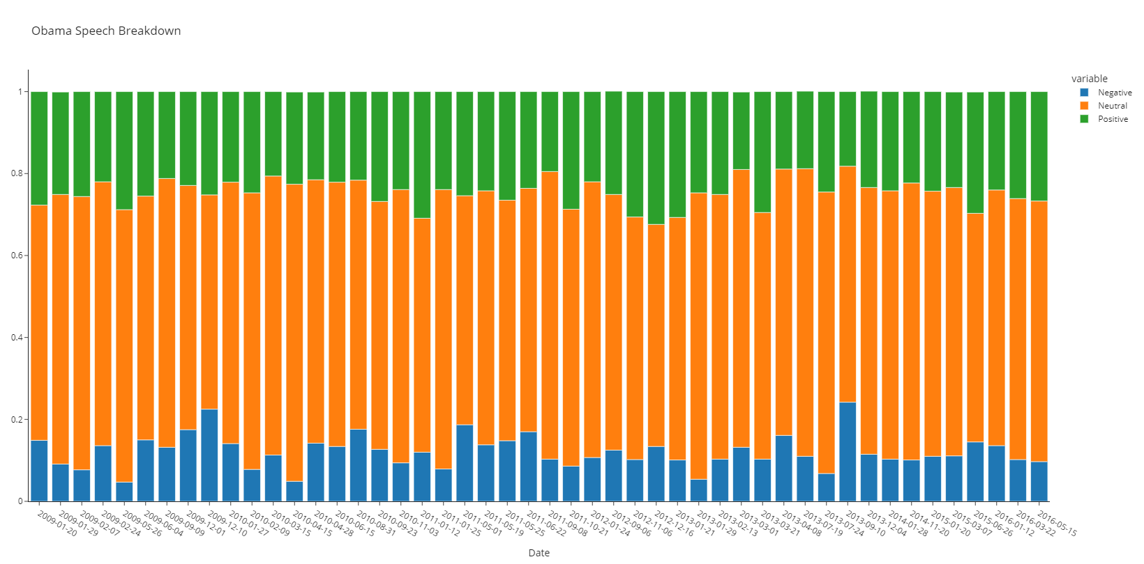
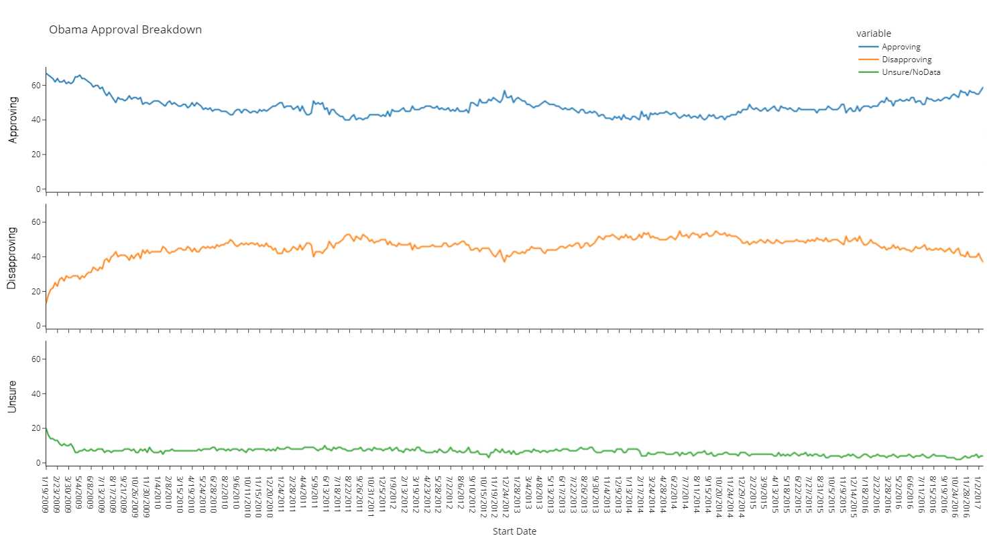
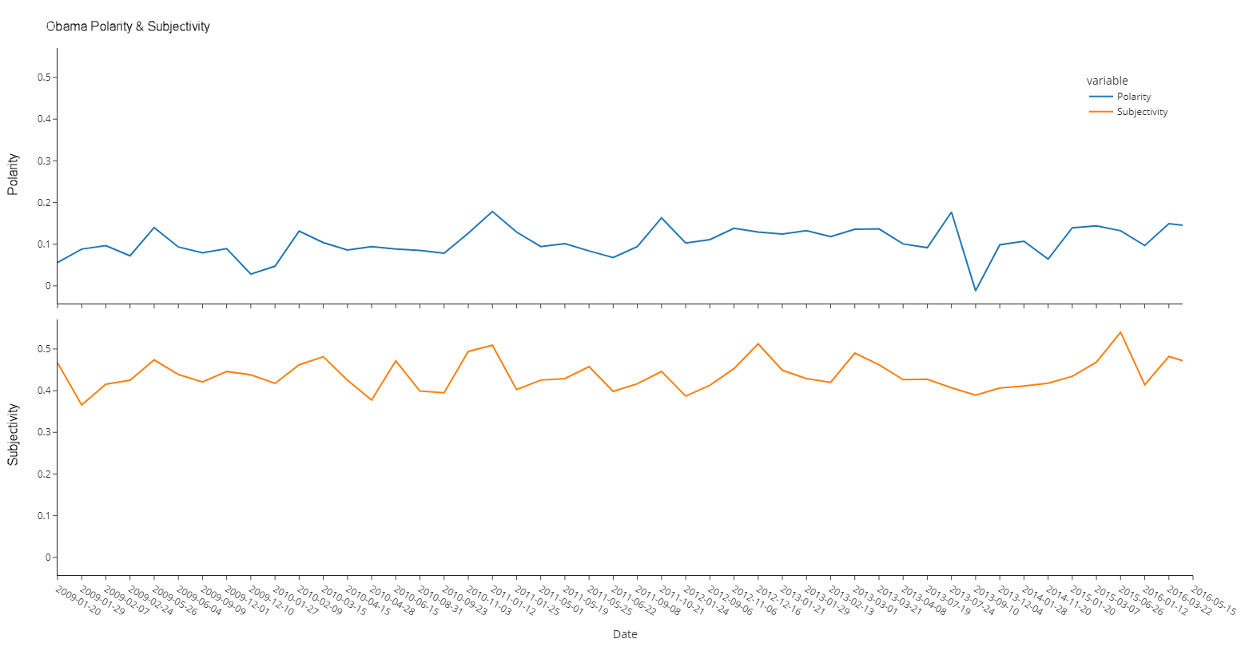
Barack Obama
Approval/Disapproval Mirroring
Approving initial drop but mostly steady after
The Address concerning Syria (2013-09-10)
Notes:
Syria 2013-09-10 – Extremely high Negative and low Polarity, one of the lowest subjectivity

Slide 8
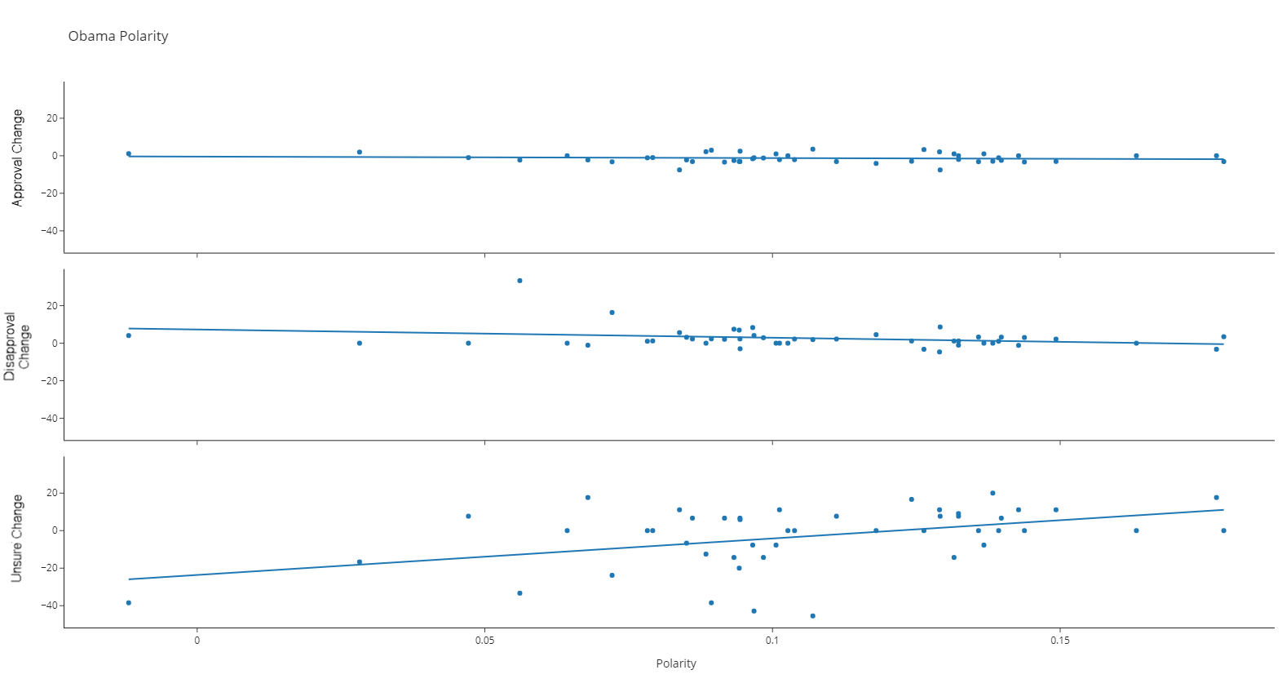
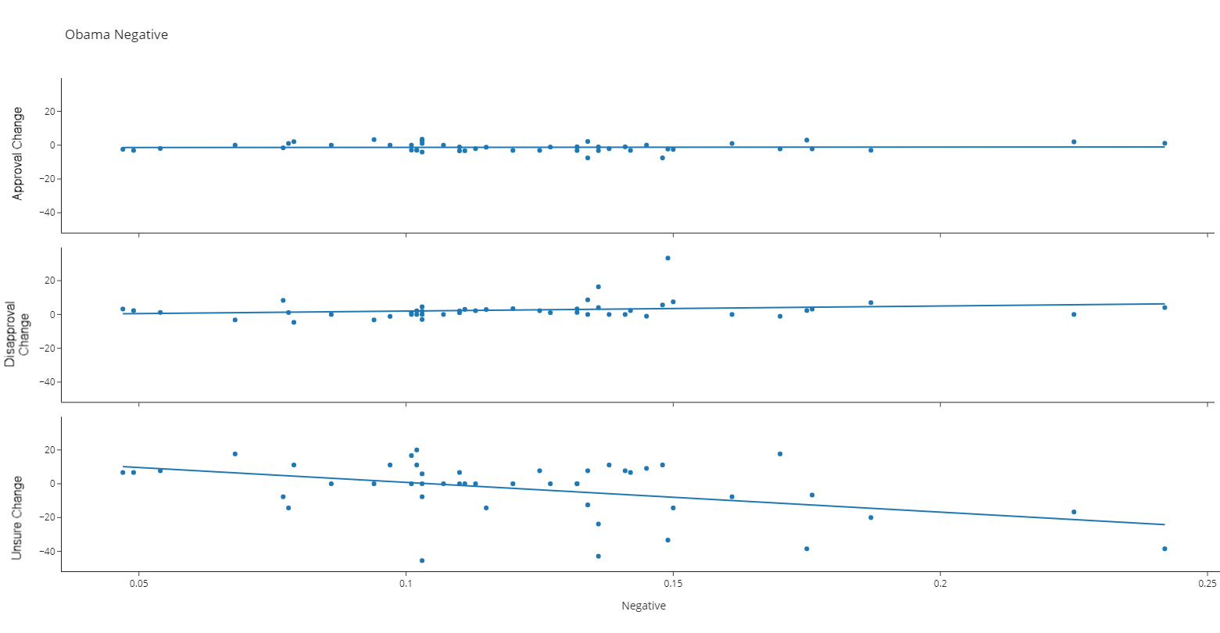
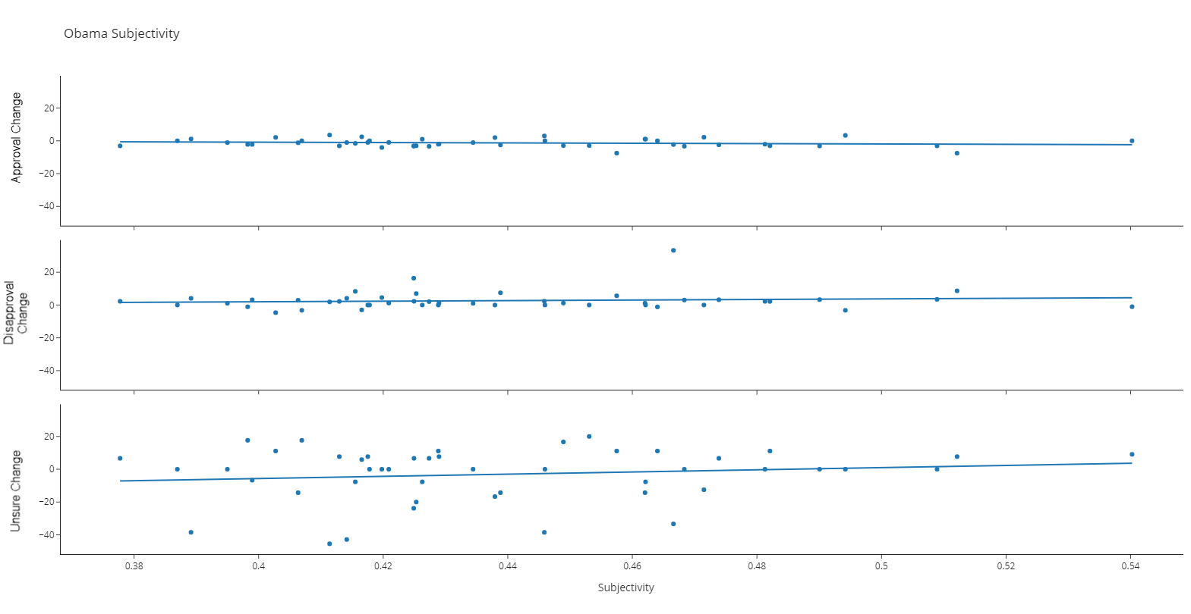
Barack Obama
Definite directionality in the Unsure Change vs Polarity and Negativity.
Other 3 indicators like Subjectivity

Slide 9
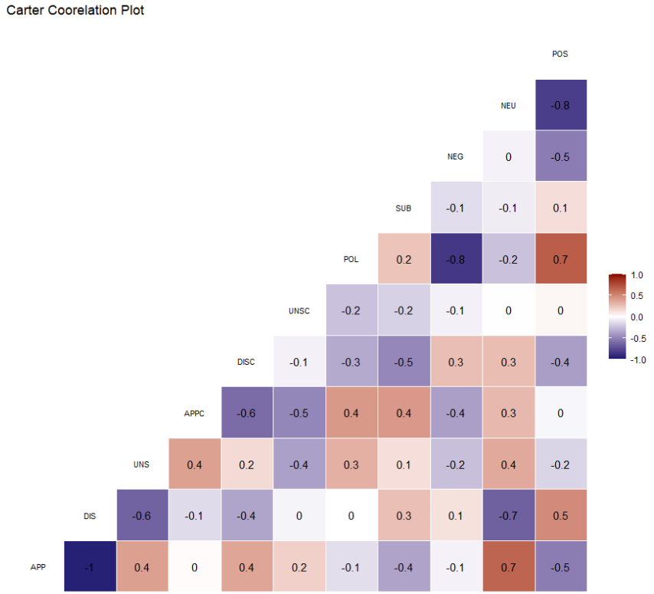
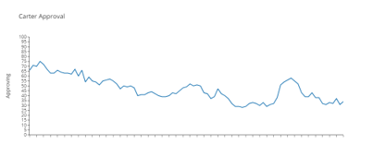
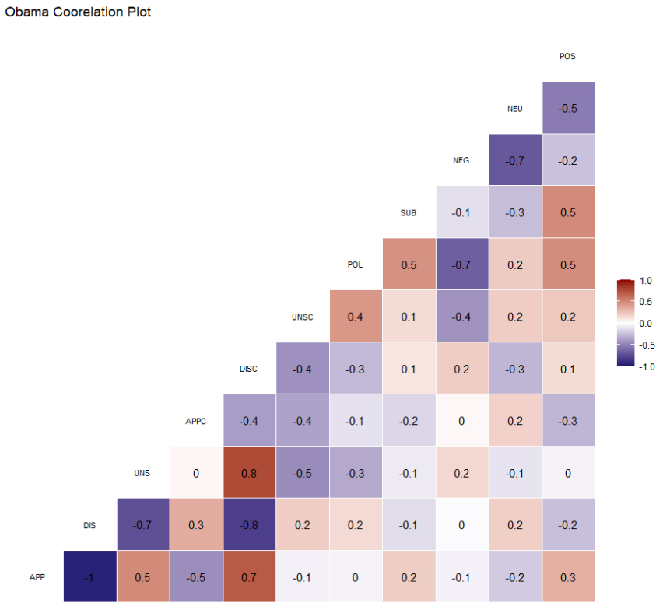
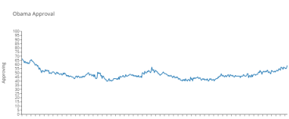
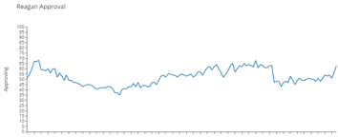
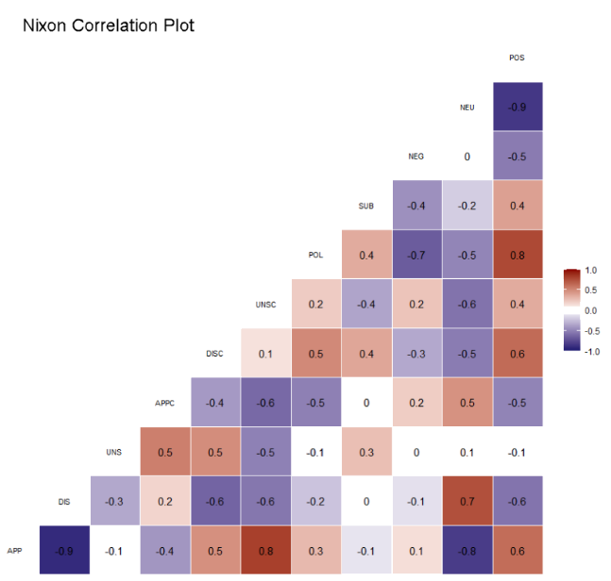
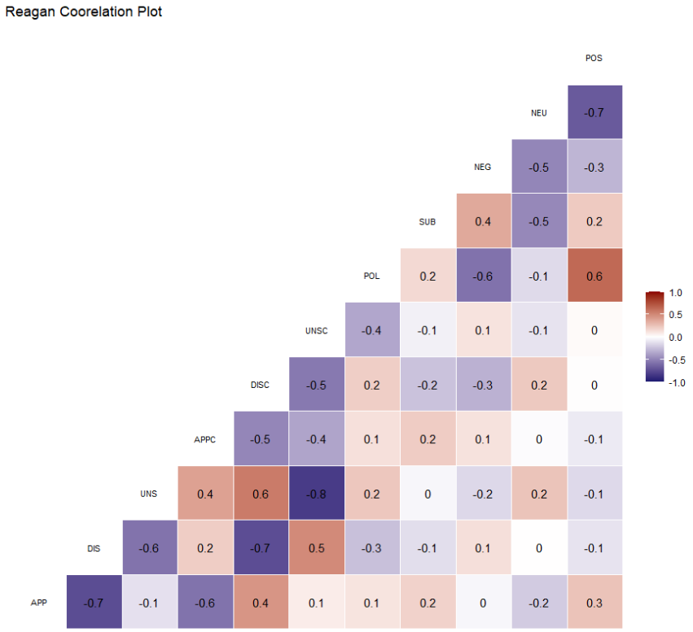
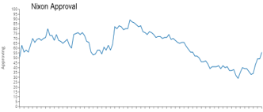
Notes:
Every president sampled when approval had sustained downward trends, the Neutral and Approving/Disapproving coefficient had large correlation.
Most cases, Positive sentiment had effects as well, however, it was not always in the same direction.

Slide 10
Conclusions
Can we determine if the words of the president effect the people of the nation?
Yes, we can see correlation between the approval numbers and specific areas of the 5 key speech indicators
If we can detect the effect of the words, can we track any useable trends for future presidents, speechwriters, or researchers?
Yes, we created a model to easily determine the value of speech content.
As to trends, If the approval numbers are in constant downward trends:
Final Thoughts:
Use more emotional words.
Neutrality is a rut, and a rut could be a grave with both ends kicked out.
If the speech is full of what I refer to as zero sum words (Neutral), the reception of the speech may not be what you expect.
Areas of additional research:
Create a specific sentiment library geared to public speakers, does the new engine change this research?
Can a prediction model be possible with the new library.
Determine if the Neutral/Approving ratio is still highly correlated in other scenarios such as when the Approval number has a large curve analysis could be:
From the peak of Approval to the base of the valley and from the base of the valley to the next peak
Next steps
Final Thoughts
Additional Areas of research
1
2

